Slide 1
Customer Retention
Power Point Presentation of
Name:
Prashant Pathak (INT33)

Slide 2
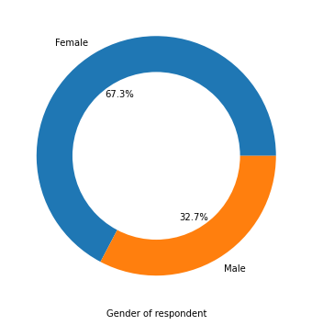

Slide 3
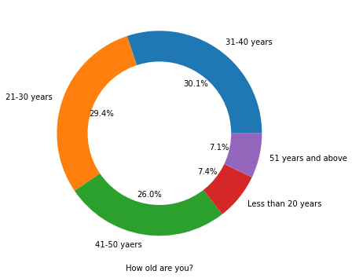

Slide 4
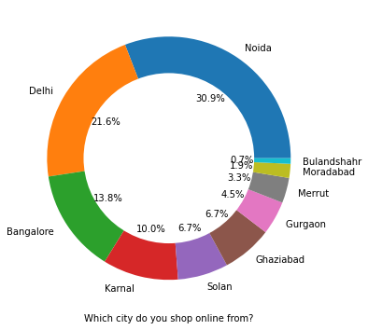

Slide 5
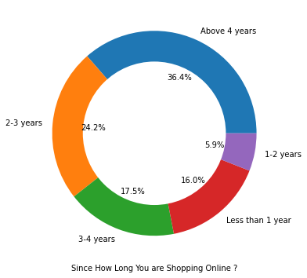

Slide 6
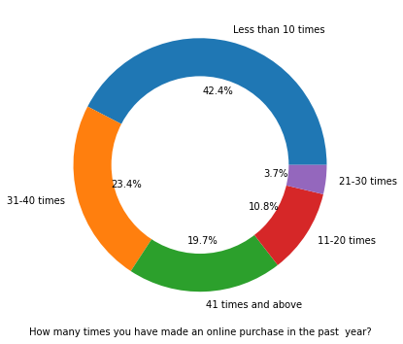

Slide 7
There is double the number of women than men who have taken this survey. - Most of the people are in their 30's followed by 20's, teenagers and senior citizen are the least in number. -Most of the people belong from Delhi, Noida and Banglore, ambiguity can also be seen as Noida has two categories (Noida and Grater Noida) which need to be handled -Most of the people shopping online have been shopping from a long time. - Majority of people shop online 10 times a year, amiguity can also be seen for range 42 times and above which needs to be handled.

Slide 8
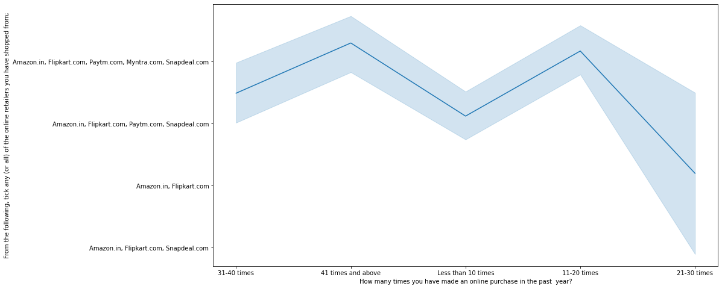
Heavy shoppers who shop more than 41 times a year shop from all the online brands, some of the people who shop for 32-40 and less than 10 times a year seem to exclude myntra. People shop from Amazon and flipkart whatever be the case.

Slide 9
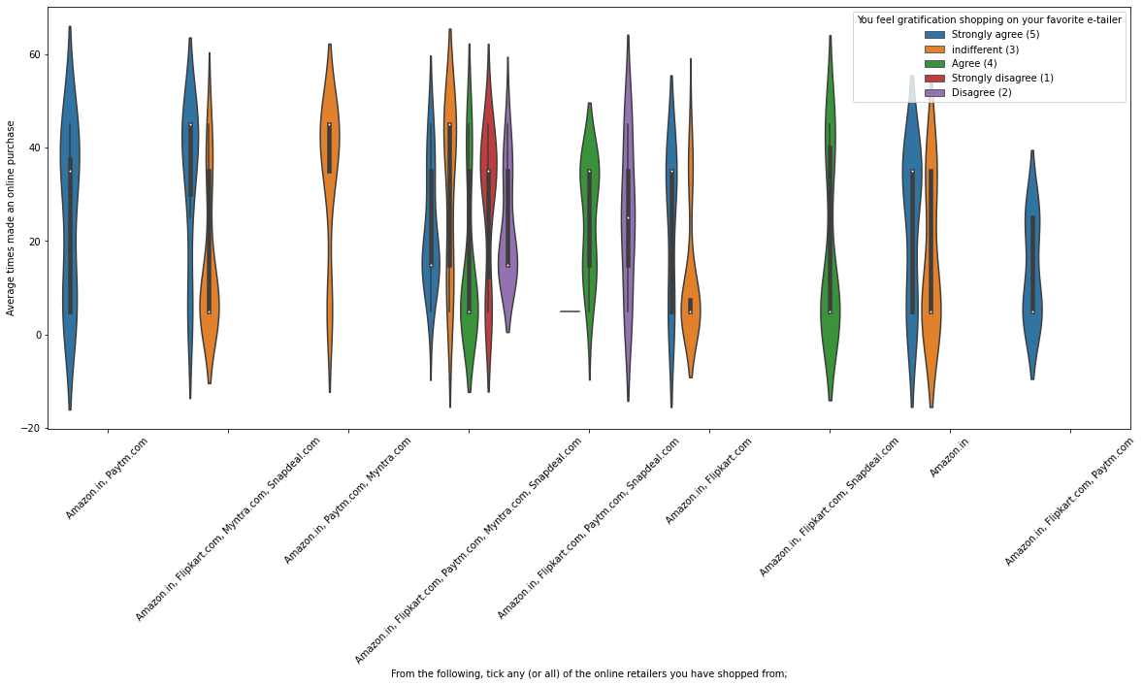
Almost all the people who have shopped from amazon, flipkart and paytm are satisfied. People who shop from a more number of online brands dosent seem to be satisfied.

Slide 10
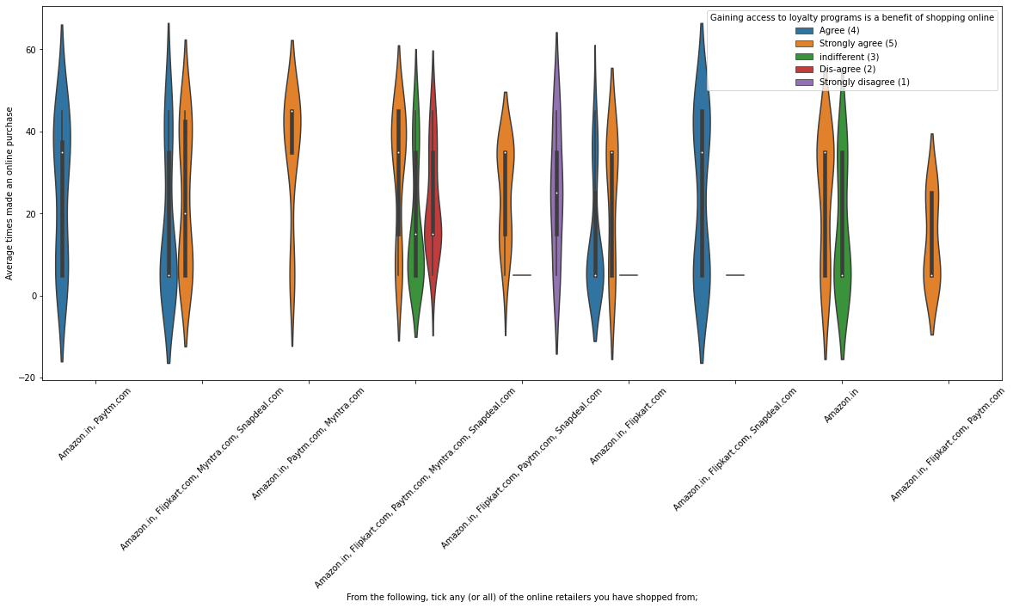
People shopping from amazon and paytm are getting benefits from the loyalty points, flipkart and sanpdeal also seem to give such benefits but people who shop from almost everywhere disagree with this statement too.

Slide 11
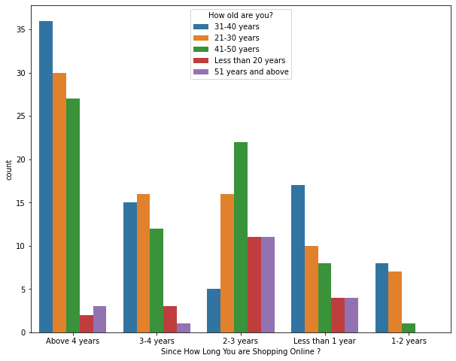
Highest number of people have been shopping online for above 4 years except for the age group below 20 years and above 50 years. People who are shopping online for 1-2 years does not include teenagers and elder people.

Slide 12
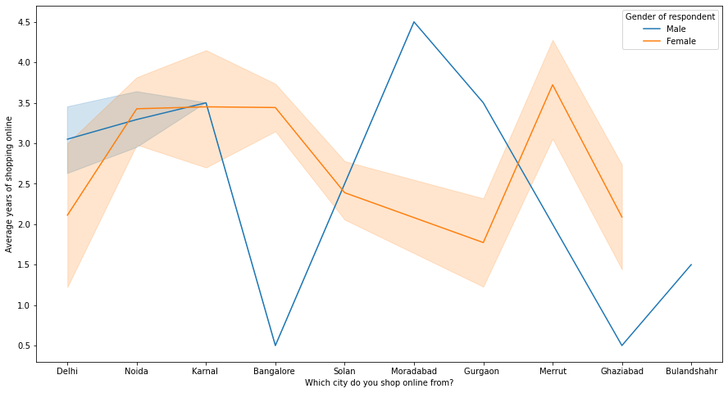
In lines, we can see that density of female customers is more than male. Men living in banglore and ghaziabad shop have shopped online for less than 1 year. Highest number of men shopping online belong from delhi and noida, while men from moradabad have been shopping online for the longest. Women from meerut and noida have shopped the longest.

Slide 13
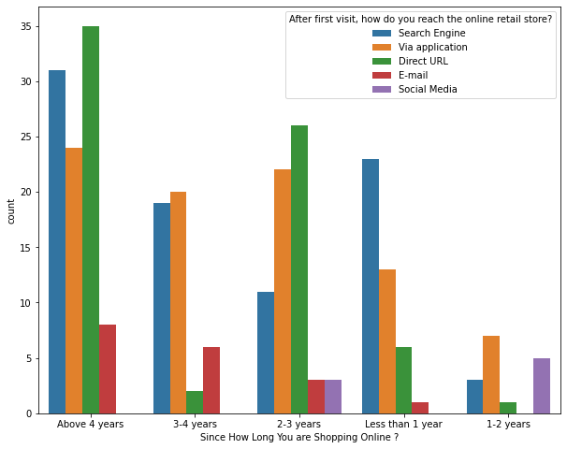
Even though people who are shopping online for more than 3 years donot use the application rather use search engine and direct url's in large number which indicates that online brands should update all their platforms rather than just application.

Slide 14
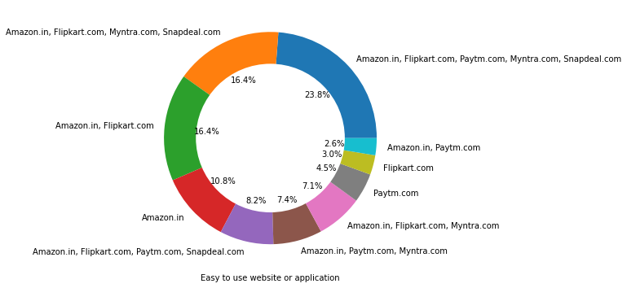
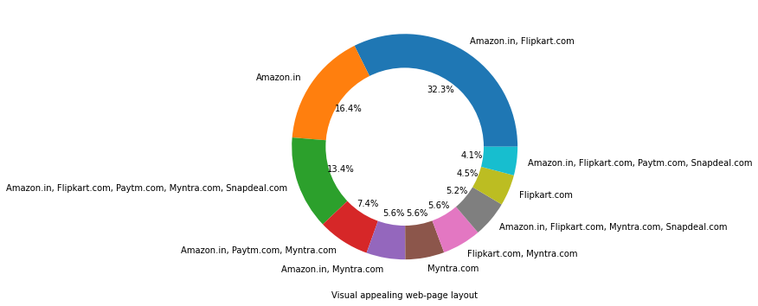

Slide 15
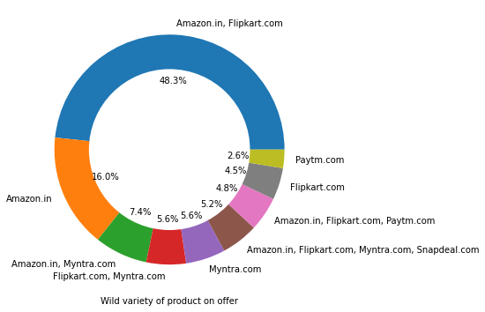
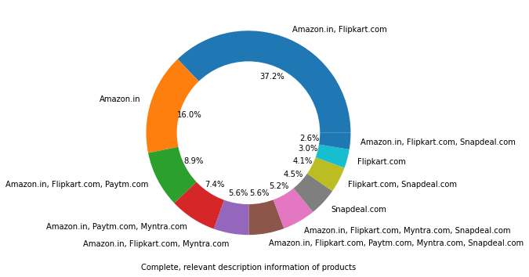

Slide 16
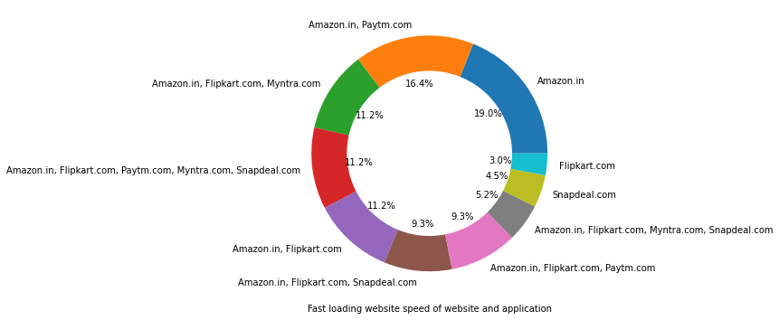
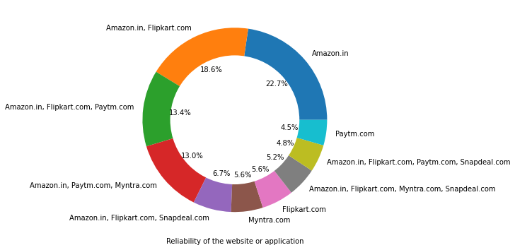

Slide 17
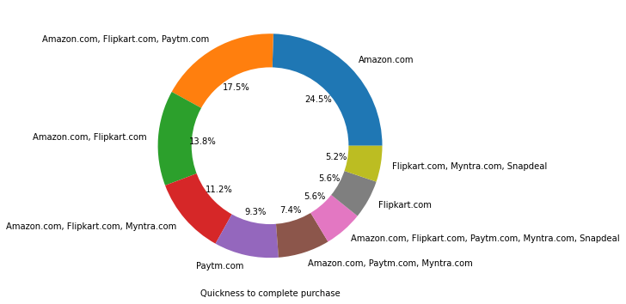
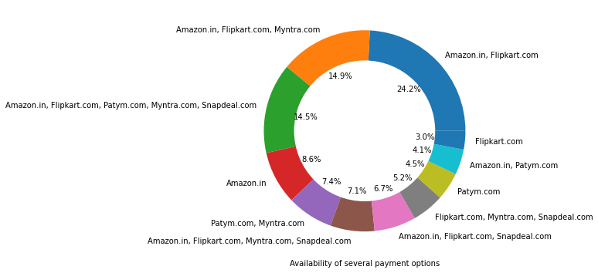

Slide 18
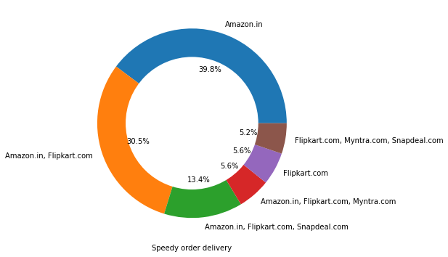
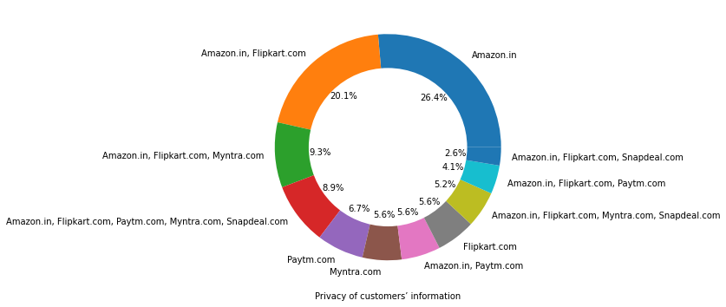

Slide 19
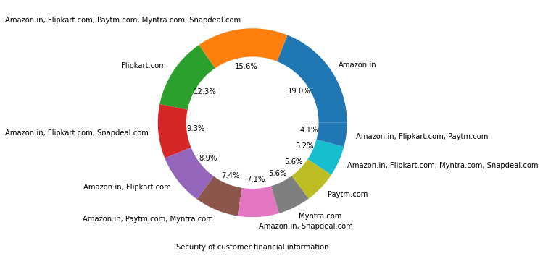
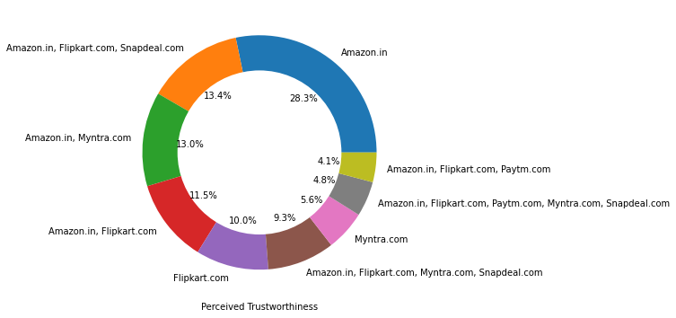
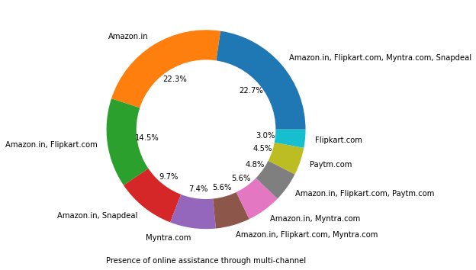
Amazon, Flipkart have been had the highest votes for having all the positive points and have maintained a very good brand image followed by paytm and the myntra.

Slide 20
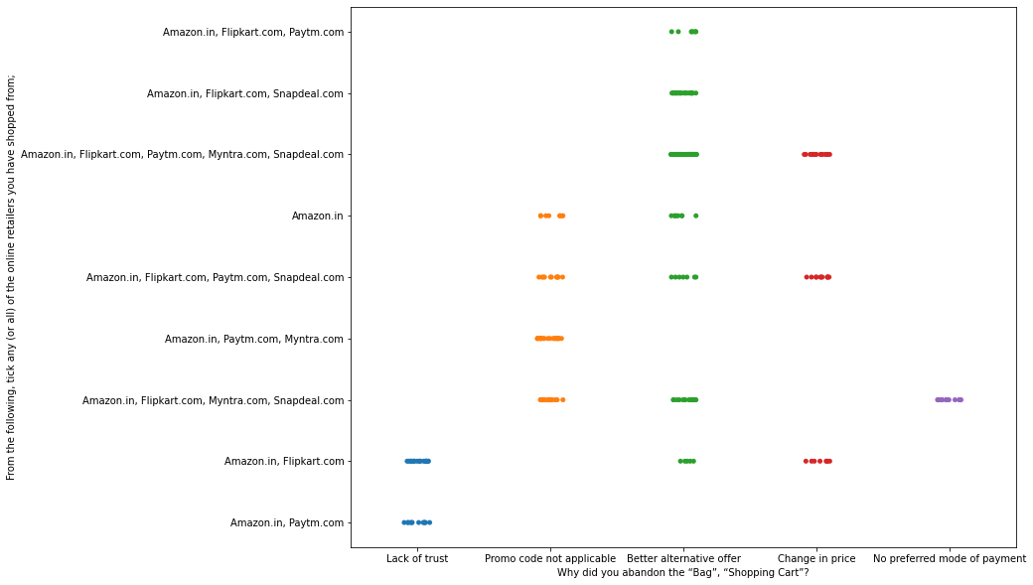
We can clearly see that most of the time people abandon the bag is beacuse they get a better alternative offer or promo code not applicable. There is also lack of trust seen in amazon, flipkart and paytm by some people. Loyalty: Loyal customers are those who keep using the same brand even if it is not good as other brands.

Slide 21
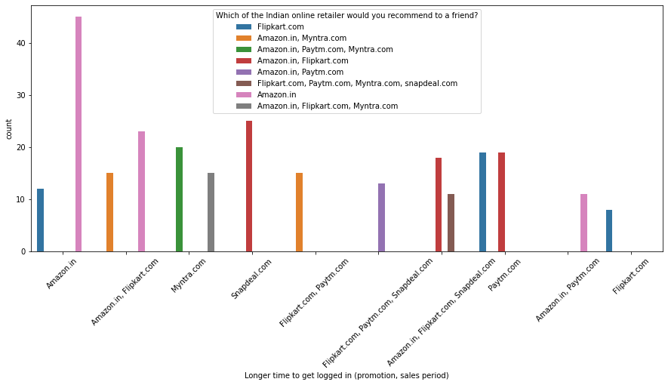
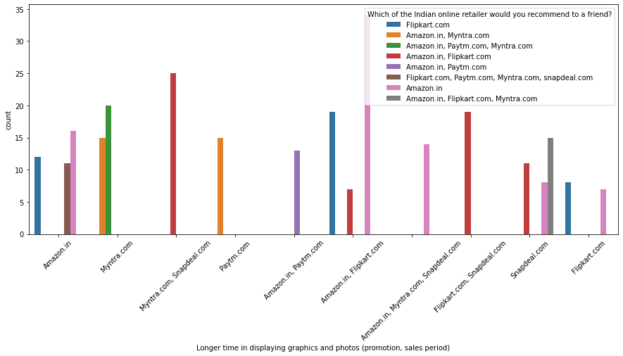
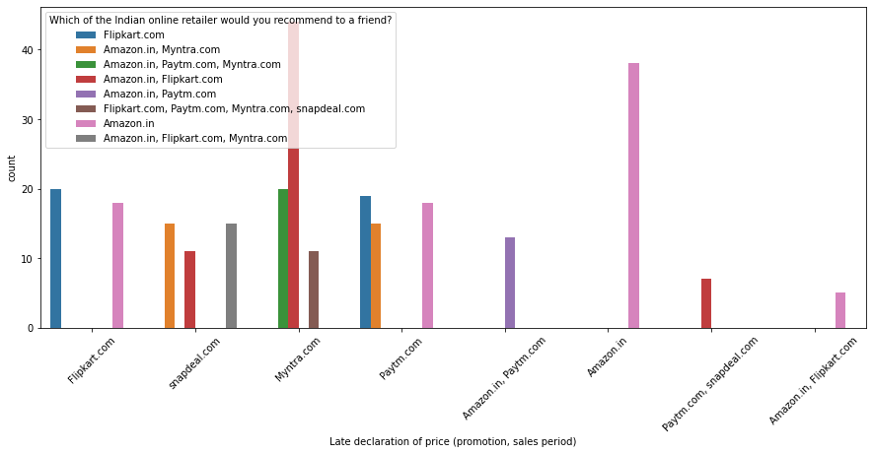
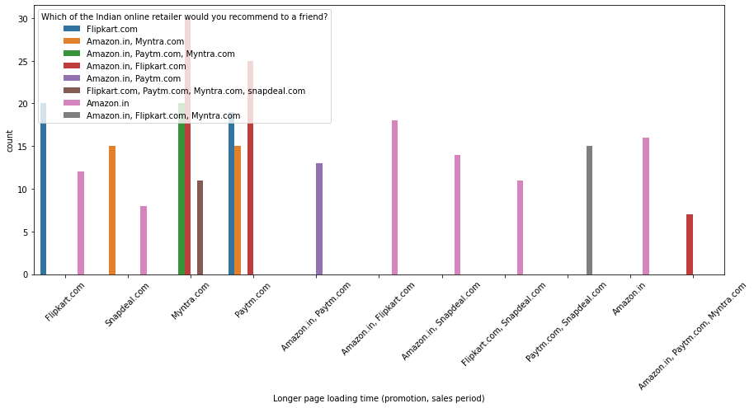

Slide 22
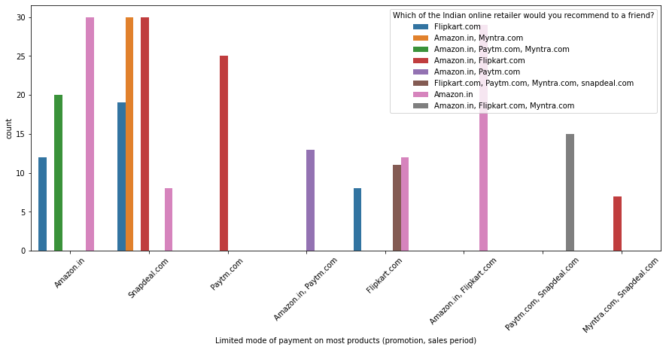
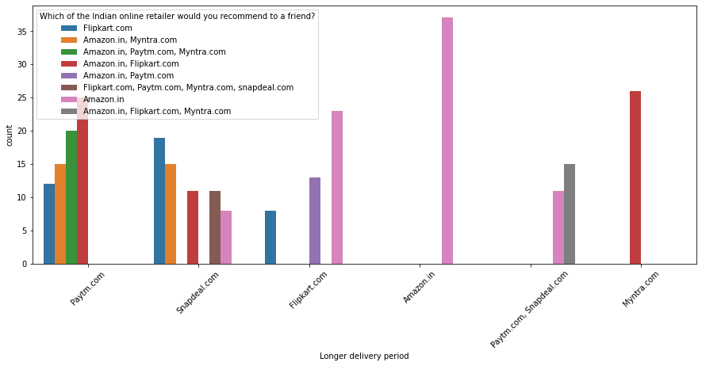
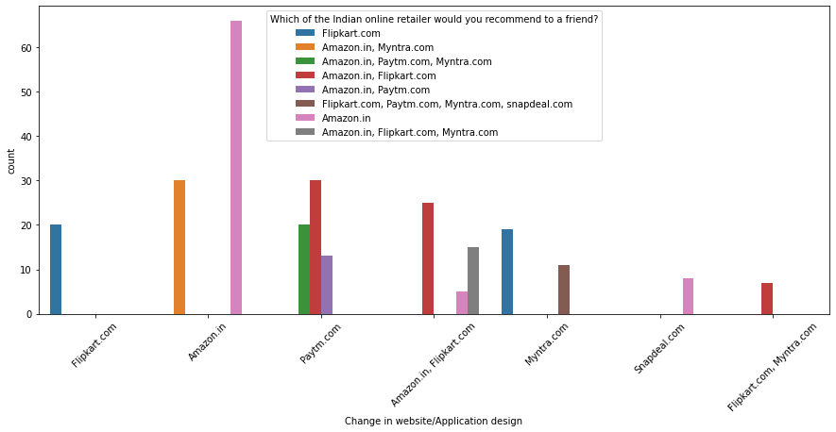
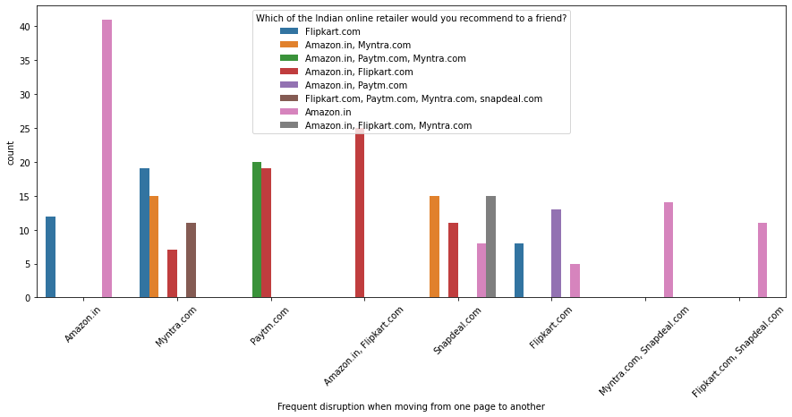
Customers seem to be more loyal to amazon, flipkart and paytm as even though many of them have given negative remarks about them still they would recommend these platforms to their friend.

Slide 23
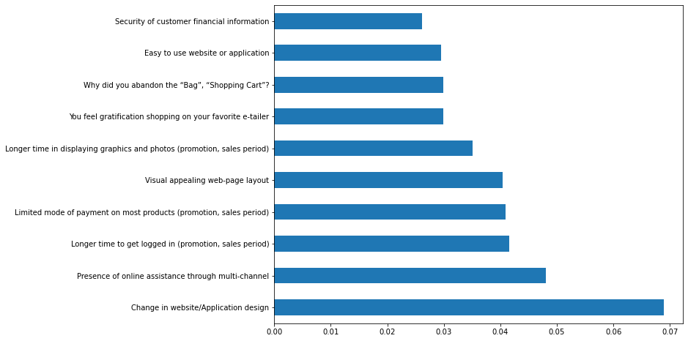
In the above chart we can see that above features are of most importance in determining whhich platform will a ciustomer recommend to his friend.

Slide 24
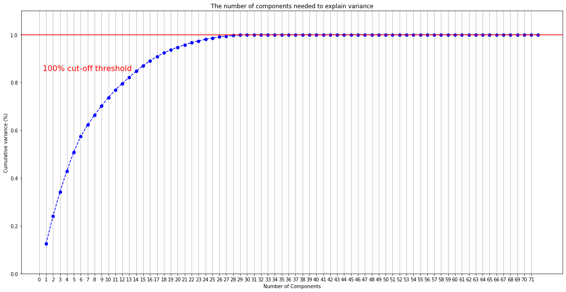
We can clearly see that with 29 features all the information can be retained.

Slide 25
Conclusion:
The results of this study suggest following outputs which might be useful for E-commerce websites to extend their business 1. The cost of the product, the reliability of the E-commerce company and the return policies all play an equally important role in deciding the buying behavior of online customers. The cost is an important factor as it was the basic criteria used by online retailers to attract customers. The reliability of the E-commerce company is also important, as it is even required in offline retail. It is important because customers are paying online, so they need to be sure of the security of the online transaction. The return policies are important because in online retail the customer does not get to feel the product. Thus, he wants to be sure that it will be possible to return the product if he does not like it in real. Whereas, the logistics factor, which included Cash on delivery option, one day delivery and the quality of packaging plays a secondary role in this process though these are Must-be-quality. This is so because these all do not interfere with the real product and people believe that this is the basic value that E-commerce websites provide. 2. All the websites were not equally preferred by online customers. Amazon was the most preferred followed by Flipkart. This can be explained easily by the previous result that we got. These two companies are most trusted in the industry and hence, have huge reliability. Also, the sellers listed on these websites are generally from Tier 1 cities as compared to Snapdeal and PayTM which have more sellers from tier 2 and 3 cities. Also, these websites have the most lenient return policies as compared to others and also the time required to process a return is low for these

